Slide 1
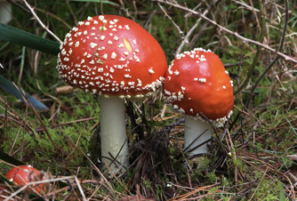

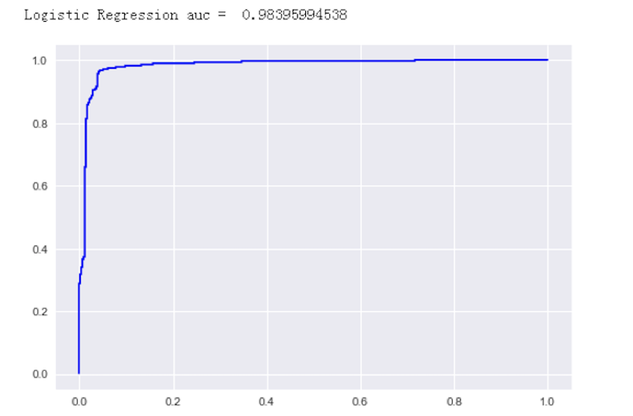
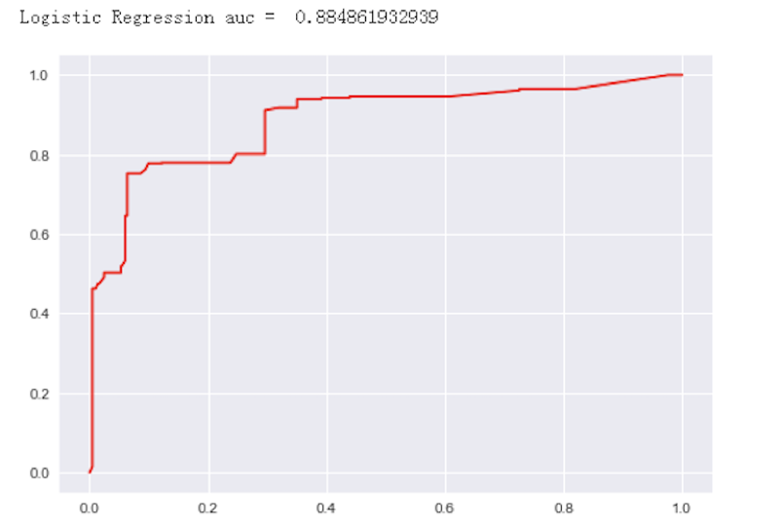
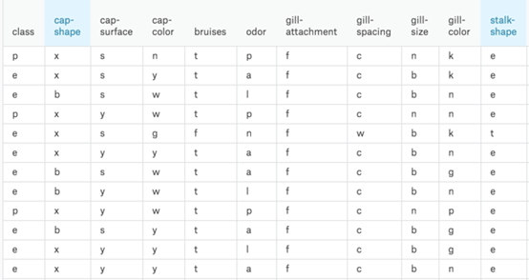
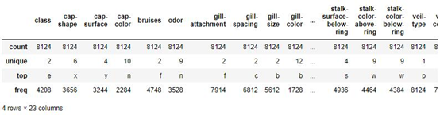
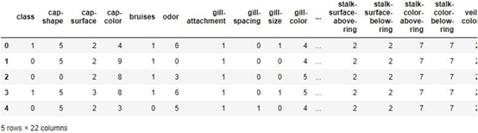
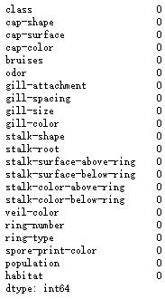
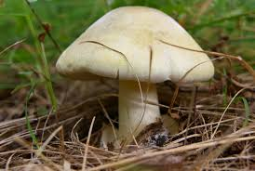
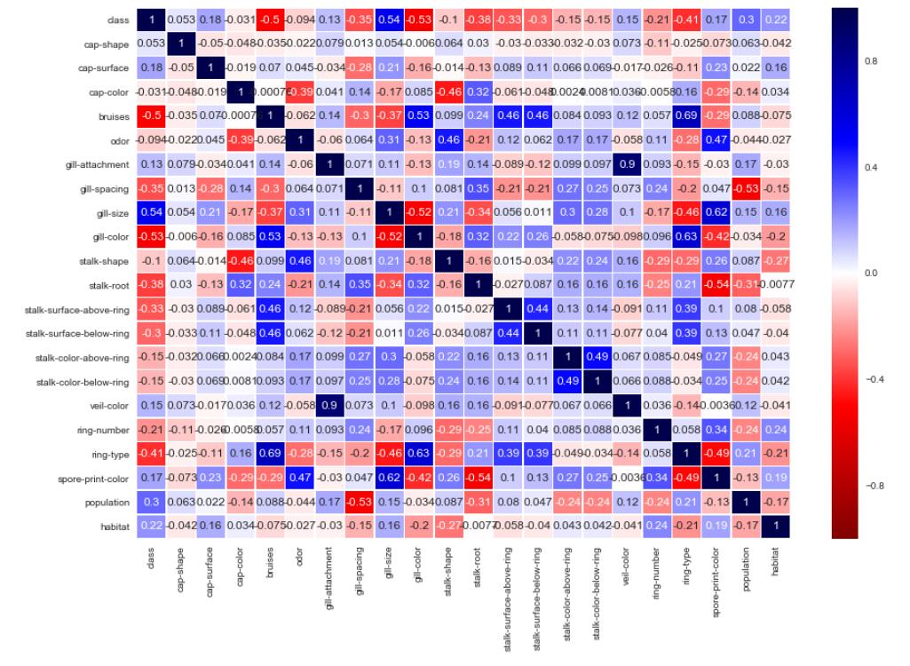
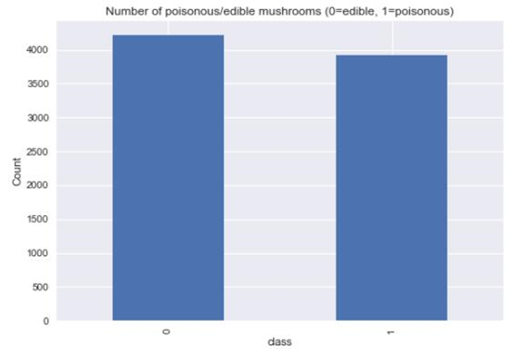
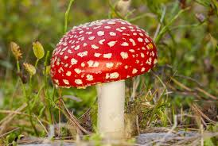
Wild Mushroom Identification Instructor: Yifan Hu Xiang Yang, Ruiwen Shi, Shikuan Gao, Haoran Du
Business Intelligence & Analytics
Introduction
Mushroom, obtainable and common out in the field, is a good source of protein, vitamin and several minerals. However, only some of them are edible while the others are poisonous even fatal, which makes identifying them crucial. Our simulation tries to find the relationship between certain physical features of a mushroom and its poisonousness.
Objective
To create a model that can accurately classify whether mushroom is edible or not.
Modeling
AUC and ROC curve of model with all features
AUC and ROC curve of the model with top 4 correlated features
Data Understanding
Raw data from Kaggle
Dataset with 23 species of gilled mushrooms
Over 8000 variables and 23 attributes
Each attribute influences on the outcome of a single type of mushroom is edible or poisonous.
Data set
Data check
Results
The AUC of our model that uses all the mushroom features is 0.984 and accuracy of that is 0.956, which is pretty good and means our model can accurately classify whether a mushroom is edible or poisonous. Because the high accuracy of the logistic regression model, there is little improvement space for modeling. Thus, we do not use more other algorithms to try to build more accurate models.
Data Preparation
First, check data by null check, data should have no null values, otherwise, there will be problems in building the model.
Second, since the dataset has string values, dataset needed to convert all the unique values into integers then label encoding is performed on the data.
Third, use data balance to make sure data prediction will be unbiased towards the frequent class.
Last, split the data into train data and test data according to the ratio of 8 to 2 to build and test the model.
Label Encoding
Null check
Plot correlation matrix Data Balance
Inspiration
Given the high accuracy of the model with all features, we wondered what the model would be like if we use only top 4 correlated-to-class features.
As the AUC(0.885) and accuracy(79%) are relatively much lower than the original model, the model with these 4 features is not that good.
Edible
Poison

